Slide 2
In this project, we aim to investigate the effectiveness of different machine learning models, including Convolutional Neural Network (CNN), Decision Tree, and Random Forest Classifier, for training on motion sense dataset. The motion sense dataset contains readings from accelerometers and gyroscopes, and we will explore the impact of feature fusion by training models using accelerometer readings, gyroscope readings, and both accelerometer and gyroscope readings.
We will start by pre-processing the motion sense dataset, which involves data cleaning, normalization, and feature extraction. We will then split the dataset into training, validation, and testing sets. Next, we will train the machine learning models using the training data separately with accelerometer readings, gyroscope readings, and both accelerometer and gyroscope readings

Slide 3
After training, we will evaluate the accuracy of each model using the validation set and compare their performance. We will analyse the results to determine which model performs the best with each type of sensor data. Additionally, we will investigate the impact of feature fusion by comparing the accuracy of the models trained with accelerometer-only, gyroscope-only, and combined accelerometer and gyroscope readings.
Finally, we will select the best-performing model and fine-tune it using hyperparameter tuning techniques to optimize its performance. We will then evaluate the optimized model using the testing set and report the final accuracy. The findings of this project will provide insights into the effectiveness of different machine learning models for training on motion sense dataset, and the impact of feature fusion on their performance. The results may have potential applications in various domains, such as health monitoring, activity recognition, and wearable technology.

Slide 6
Human posture and activity recognition have become significant areas of research in the field of wearable technology and human-computer interaction. Accurate recognition of human postures and activities can have numerous applications, such as health monitoring, fitness tracking, gesture recognition, and human-computer interaction in virtual reality and augmented reality systems. One common approach to achieve posture and activity recognition is through the use of motion sensors, such as accelerometers and gyroscopes, which are commonly found in wearable devices such as smartwatches, fitness trackers, and smartphones.
Motion sense dataset is a widely used dataset for human posture and activity recognition research. It consists of sensor readings from accelerometers and gyroscopes, collected from a group of participants performing various activities, such as walking, running, standing, sitting, and lying down. The dataset provides a rich source of information for training machine learning models to recognize human postures and activities accurately

Slide 7
Feature fusion, which involves combining data from multiple sensors or modalities, has been shown to improve the accuracy of posture and activity recognition models. By fusing data from different sensors, such as accelerometers and gyroscopes, the models can capture complementary information and obtain a more comprehensive understanding of human postures and activities.
In this project, we aim to explore the impact of feature fusion on the accuracy of human posture and activity recognition using the motion sense dataset. We will train different machine learning models, including Convolutional Neural Network (CNN), Decision Tree, and Random Forest Classifier, with different combinations of sensor data, including accelerometer-only, gyroscope-only, and combined accelerometer and gyroscope readings. We will evaluate the performance of these models and compare their accuracies to determine the effectiveness of feature fusion in improving the accuracy of human posture and activity recognition.
The findings of this project may have implications in various domains, such as healthcare, sports, gaming, and virtual reality, where accurate recognition of human postures and activities is essential. The results can contribute to the development of more accurate and robust posture and activity recognition systems, leveraging the potential of feature fusion for improved performance.

Slide 8
We’ll do feature Fusion using these three combinations:
Accelerometer Readings | Gyroscope Readings | Accelerometer + Gyroscope Readings
These are sensors that measure the acceleration of an object in three-dimensional space. | These are sensors that measure the angular velocity or rate of rotation of an object in three-dimensional space. | These measure the acceleration, angular velocity or rate of rotation of an object in three-dimensional space.
Table 1.1 Feature Fusion Combinations

Slide 9
Approaches used to compare the combinations above are:
Decision Tree Classifier: The Decision Tree Classifier is implemented using the DecisionTreeClassifier class from the sklearn.tree module. This classifier is a type of Supervised Learning algorithm used for classification tasks. It creates a tree-like structure where each internal node represents a feature (e.g., accelerometer data in this case) and each leaf node represents a class label (e.g., activity type). The tree is built by recursively splitting the data based on the feature that best separates the data into different classes. The fit() function is called on the dtc object to train the Decision Tree Classifier using the training data X (features) and y (target labels).
Random Forest Classifier: The Random Forest Classifier is implemented using the RandomForestClassifier class from the sklearn.ensemble module. This classifier is an ensemble method that combines multiple decision trees to improve the accuracy and robustness of the model. It creates a collection of decision trees (i.e., forest) and makes predictions by averaging the predictions of all individual trees. The n_estimators parameter is used to specify the number of decision trees in the forest. The fit() function is called on the rfc object to train the Random Forest Classifier using the training data X (features) and y (target labels).

Slide 10
3.Convolutional Neural Network (CNN): The CNN is implemented using the Sequential class from the keras.models module. This classifier is a type of Deep Learning algorithm that is well-suited for processing grid-like data such as images or time-series data. The Sequential class is used to define a linear stack of layers in the neural network. In this code, the CNN has four layers: an input layer with 3 input dimensions (for accelerometer data), two hidden layers with 80 and 40 neurons, respectively, and an output layer with 6 neurons (for 6 activity types). The relu activation function is used in the hidden layers, and the softmax activation function is used in the output layer to convert the predicted scores into class probabilities. The categorical_crossentropy loss function is used for multi-class classification, and the Adam optimizer is used to optimize the model parameters. The fit() function is called on the cnn object to train the CNN using the training data train_X (features) and train_y (target labels).
In addition to the classifiers, the code also includes a function cnn_test_results() that takes a trained CNN model and a dataframe df as inputs, and prints out the accuracy of the model on the dataframe for each activity. The accuracy is calculated by comparin the predicted activity labels with the ground truth labels in the dataframe. The accuracy is a measure of how well the model is able to correctly classify the activities based on the accelerometer data

Slide 11
Human posture and activity recognition using motion sense datasets has gained significant
attention in recent years due to its potential applications in areas such as healthcare, sports, and human-computer interaction. Various machine learning models, including convolutional neural networks (CNNs), decision trees, and random forest classifiers, have been used to classify human postures and activities based on data collected from accelerometers and gyroscopes. Additionally, the concept of feature fusion, where data from multiple sensors are combined, has been explored to potentially improve the accuracy of these models.
Several studies have investigated the use of CNNs for human posture and activity recognition. CNNs are deep learning models that can automatically learn hierarchical features from raw sensor data, making them well-suited for processing time-series data from accelerometers and gyroscopes. For example, Zhang et al. (2019) utilized CNNs to classify human activities based on accelerometer and gyroscope data, achieving high accuracy in recognizing activities such as walking, running, and jumping. Similarly, Yilmaz et al. (2019) used CNNs to classify human postures based on accelerometer data, achieving promising results in distinguishing between different postures such as standing, sitting, and lying.

Slide 12
Decision trees and random forest classifiers have also been used in human posture and activity recognition. Decision trees are tree-like structures that recursively split the data based on feature values to make decisions, while random forest classifiers are ensemble methods that combine multiple decision trees to improve accuracy and reduce overfitting. For instance, Romero et al. (2017) used decision trees to classify human postures based on accelerometer data, achieving high accuracy in recognizing postures such as sitting, standing, and lying. Similarly, Farooq et al. (2018) utilized random forest classifiers to recognize human activities based on accelerometer and gyroscope data, achieving competitive accuracy in recognizing activities such as walking, jogging, and climbing stairs.
Feature fusion, or combining data from multiple sensors, has been explored as a strategy to improve the accuracy of human posture and activity recognition models. By leveraging data from accelerometers and gyroscopes simultaneously, feature fusion can capture complementary information from both sensors, potentially leading to improved accuracy in classification. For instance, Khan et al. (2019) combined accelerometer and gyroscope data and used random forest classifiers to classify human activities, achieving higher accuracy compared to using each sensor separately. In summary, various machine learning models, including CNNs, decision trees, and random forest classifiers, have been used in human posture and activity recognition based on motion sense datasets. Additionally, feature fusion, where data from accelerometers and gyroscopes are combined, has been explored to potentially improve the accuracy of these models. These studies have shown promising results in recognizing human postures and activities, and the use of different models and feature fusion can be further investigated to determine the most effective approach for accurate and robust human posture and activity recognition.

Slide 13
Proposed Work:
Data Collection: Obtain the MotionSense dataset, which contains accelerometer and gyroscope readings collected from smartphones. The dataset consists of labeled data from various physical activities such as walking, running, sitting, standing, etc. Data will be collected from multiple subjects to ensure diversity.
Data Preprocessing: Perform data preprocessing to clean and prepare the dataset for training. This may involve removing noise, normalizing the data, and splitting it into training, validation, and testing sets.
Feature Extraction: Extract relevant features from the accelerometer and gyroscope readings. This may include statistical measures such as mean, variance, and standard deviation, as well as other domain-specific features that can capture the characteristics of human motion.
Model Training: Train three different models using the motion sense dataset. The first model will be trained using only accelerometer readings, the second model using only gyroscope readings, and the third model using both accelerometer and gyroscope readings. The models will be implemented using Convolutional Neural Networks (CNN) for accelerometer and gyroscope data, and Decision Tree and Random Forest Classifier for accelerometer and gyroscope data, respectively.
Feature Fusion: Implement feature fusion techniques to combine the features extracted from both accelerometer and gyroscope readings. This may involve concatenating, averaging, or other fusion methods to create a combined feature representation that can capture the complementary information from both sensors.

Slide 14
Model Evaluation: Evaluate the accuracy of the trained models using appropriate evaluation metrics such as accuracy, precision, recall, and F1-score. Compare the performance of the three models trained with accelerometer, gyroscope, and fused features to determine which approach yields the highest accuracy.
Analysis and Discussion: Analyze the results obtained from the experiments and discuss the findings. Identify the strengths and weaknesses of each model and provide insights on the impact of feature fusion on model performance. Discuss the potential applications of the trained models in real-world scenarios such as activity recognition, health monitoring, and sports performance analysis.
Conclusion: Summarize the findings and conclusions of the study. Highlight the significance of the proposed work in advancing the field of human motion sensing and its potential applications. Identify future research directions and possible improvements to the proposed approach.
References: Provide a comprehensive list of references that were consulted during the project, including relevant research papers, textbooks, and online resources.
Implementation: Provide the implementation details of the proposed work, including the programming language, libraries, frameworks, and tools that will be used to develop and train the models. Include the necessary code snippets and configuration details to replicate the experiments

Slide 15
Methodology:
System Requirements:
You will need to ensure that the following libraries are installed:
Pandas, NumPy, scikit-learn (sklearn), Keras, Matplotlib, TensorFlow
Dataset:
We are using “MotionSense Dataset” here for our project
This dataset includes time-series data generated by accelerometer and gyroscope sensors (attitude, gravity, userAcceleration, and rotationRate). It is collected with an iPhone 6s kept in the participant's front pocket using SensingKit which collects information from Core Motion framework on iOS devices. A total of 24 participants in a range of gender, age, weight, and height performed 6 activities in 15 trials in the same environment and conditions: downstairs, upstairs, walking, jogging, sitting, and standing.
There are 24 data subjects. The A_DeviceMotion_data folder contains time-series collected by both Accelerometer and Gyroscope for all 15 trials. For every trial we have a multivariate time-series.
Thus, we have time-series with 12 features: attitude.roll, attitude.pitch, attitude.yaw, gravity.x, gravity.y, gravity.z, rotationRate.x, rotationRate.y, rotationRate.z, userAcceleration.x, userAcceleration.y, userAcceleration

Slide 16
(A) DeviceMotion_data
This folder contains time-series collected by both Accelerometer and Gyroscope for all 15 trials.
Thus, we have time-series with 12 features:
attitude.roll
attitude.pitch
attitude.yaw
gravity.x
gravity.y
gravity.z
rotationRate.x
rotationRate.y
rotationRate.z
userAcceleration.x
userAcceleration.y
userAcceleration.z
The accelerometer measures the sum of two acceleration vectors: gravity and user acceleration. User acceleration is the acceleration that the user imparts to the device

Slide 17
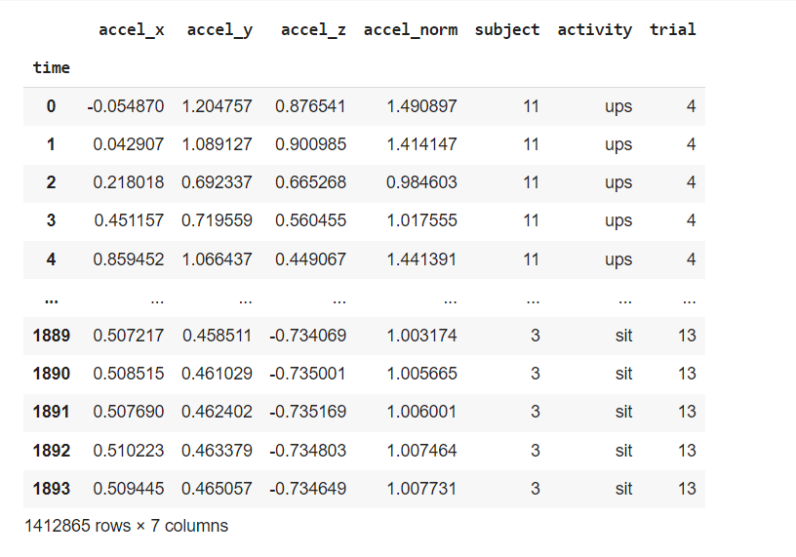
(B) Accelerometer_data
Here we just have data reported by Accelerometer sensor. Thus, there are just three features correspond to 3 different axes:
x
y
z
Figure 3.1: Accelerometer Data

Slide 18
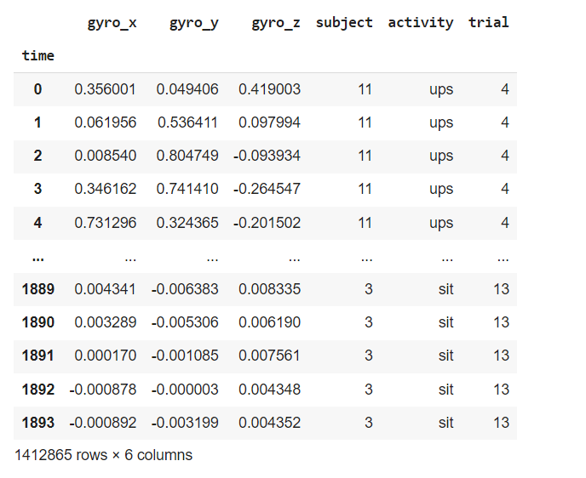
(C) Gyroscope_data
Here we just have data reported by Gyroscope sensor. Thus, there are again just three features correspond to 3 different axes:
x
y
z
Figure 3.2: Gyroscope Data

Slide 19
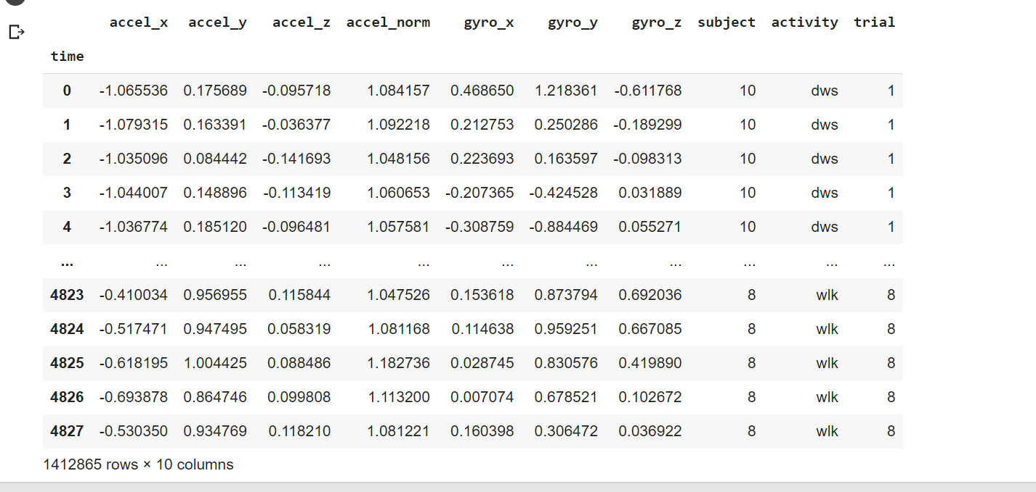
Figure 3.3: Accelerometer+Gyroscope Dataset

Slide 20
Labels
There are 6 different labels:
dws | downstairs
ups | upstairs
sit | sitting
std | standing
wlk | walking
jog | jogging
Table 3.1: Labels of the dataset

Slide 21
Pre-processing:
Segment the time-series data into fixed-length windows (e.g., 1-2 seconds), and clean and normalize the data.
Feature Engineering:
It is done for doing feature fusion
For Accelerometer Readings:
We perform feature engineering on the data by creating new columns such as 'accel_x', 'accel_y', 'accel_z', and 'accel_norm' using mathematical operations on existing columns like 'userAcceleration.x', 'userAcceleration.y’, 'userAcceleration.z', and 'gravity.x', 'gravity.y', 'gravity.z'. These new columns represent the combined acceleration and the magnitude of acceleration in different directions.
For Gyroscope readings
We perform feature engineering on the data by creating new columns such as 'gyro_x', 'gyro_y', 'gyro_z', and 'gyro_norm' using mathematical operations on existing columns like attitude.roll, attitude.pitch, attitude.yaw, rotationRate.x, rotationRate.y, rotationRate.z
These are sensors that measure the angular velocity or rate of rotation of an object
For Accelerometer+ Gyroscope readings
We perform feature engineering on the data by using mathematical operations on existing columns like attitude.roll, attitude.pitch, attitude.yaw, rotationRate.x, rotationRate.y, rotationRate.z, 'userAcceleration.x', 'userAcceleration.y', 'userAcceleration.z', and 'gravity.x', 'gravity.y', 'gravity.z'.

Slide 22
Feature Extraction:
Extract relevant features from the time-series data, such as mean, variance, and magnitude of acceleration. These features can be computed for each window of data.
Creating Lag Features:
Create lagged versions of each feature by shifting the feature values backward in time by a specified number of time steps (e.g., 1 or 2). The goal is to capture temporal dependencies and identify patterns that are specific to certain personal attributes.
By using lag features, we can capture the temporal dynamics of the sensor data and identify patterns that are specific to certain personal attributes. This can help improve the performance of machine learning models for activity recognition and personal attribute inference tasks
Removal of Overlapping Data and Combining Features:
Remove the first few rows of each window that may overlap with the last few rows of the previous window to avoid using overlapping data in the creation of lagged features.
Combine the original features and lagged features into a single feature vector for each window.

Slide 23
Training Machine Learning Models:
Train machine learning models using the feature vectors and corresponding labels for activity recognition and personal attribute inference. Use metrics such as accuracy, precision, recall, and F1 score to evaluate the performance of the models on both tasks.
Convolutional Neural Network (CNN):The CNN is implemented using the Sequential class from the keras.models module. This classifier is a type of Deep Learning algorithm that is well-suited for processing grid-like data such as images or time-series data. The Sequential class is used to define a linear stack of layers in the neural network.
For Accelerometer Data:
In this project, the CNN has four layers: an input layer with 3 input dimensions (for accelerometer data),
Two hidden layers with 80 and 40 neurons, respectively, and an output layer with 6 neurons (for 6 activity types).
The relu activation function is used in the hidden layers, and the softmax activation function is used in the output layer to convert the predicted scores into class probabilities.
The categorical_crossentropy loss function is used for multi-class classification, and the Adam optimizer is used to optimize the model parameters. The fit() function is called on the cnn object to train the CNN using the training data train_X (features) and train_y (target labels).

Slide 24
Table 3.2: CNN architechture for Accelerometer Data

Slide 25
For Gyroscope Data:
The architecture of the Convolutional Neural Network (CNN) used here is feedforward neural network with multiple dense layers (also known as fully connected layers) stacked on top of each other. The architecture of the CNN is as follows:
Input Layer: The input layer has 3 neurons representing the three gyroscope readings (gyro_x, gyro_y, gyro_z).
Dense Layer 1: This layer has 80 neurons with 'relu' activation function, which stands for Rectified Linear Unit. It is a commonly used activation function that introduces non-linearity to the network.
Dense Layer 2: This layer has 40 neurons with 'relu' activation function.
Dense Layer 3: This layer has 20 neurons with 'relu' activation function.
Output Layer: This layer has 6 neurons representing the 6 different activities (dws, ups, sit, std, wlk, jog) with 'softmax' activation function. Softmax is used for multi-class classification problems to convert the output into probability scores for each class.
The CNN is compiled with the categorical cross-entropy loss function and Adam optimizer with a learning rate of 0.01. The 'accuracy' metric is used to evaluate the performance of the model during training. The data is split into training and validation sets using the train_test_split function from sklearn.model_selection module.

Slide 26
Table 3.3: CNN Architechture for Gyroscope Data

Slide 27
For Accelerometer+Gyroscope Dataset:
Input Layer: The input layer of the CNN has 7 input nodes, representing the features extracted from the accelerometer and gyroscope data, including acceleration in x, y, and z directions, normalized acceleration (accel_norm), and gyroscope data in x, y, and z directions.
Dense Layers: The CNN has three dense (fully connected) hidden layers with different numbers of nodes. The first hidden layer has 80 nodes with the 'relu' activation function, the second hidden layer has 40 nodes with the 'relu' activation function, and the third hidden layer has 20 nodes with the 'relu' activation function. The 'relu' activation function is commonly used in deep neural networks and stands for Rectified Linear Unit, which introduces non-linearity to the model.
Output Layer: The output layer of the CNN has 6 nodes, which represents the 6 different activities ('dws', 'ups', 'sit', 'std', 'wlk', 'jog') that the model predicts. The output layer uses the 'softmax' activation function, which converts the output of each node into probabilities, indicating the probability of each activity being predicted.
Optimizer: The optimizer used in the CNN is Adam (Adaptive Moment Estimation), which is a popular optimizer for training deep neural networks. It adjusts the learning rate adaptively during training, making it efficient and effective for convergence.
Loss Function: The loss function used in the CNN is 'categorical_crossentropy', which is commonly used for multi-class classification problems with more than two classes. It measures the difference between the predicted probabilities and the actual target values.

Slide 28
Metrics: The CNN model is evaluated using the 'accuracy' metric, which calculates the accuracy of the model predictions compared to the actual target values during training and validation.
Training: The model is trained using the training data with 10 epochs (iterations) and a batch size of 200. During training, the model tries to minimize the loss function using the optimizer and updates the weights of the model's neurons. The training data is split into training and validation sets using the 'train_test_split' function from sklearn, with a portion of the data used for validation to monitor the model's performance during training and prevent overfitting.
Table 3.4: CNN Architechture for Accelerometer+Gyroscope Readings

Slide 29
Decision Tree Classifier:The Decision Tree Classifier is implemented using the DecisionTreeClassifier class from the sklearn.tree module. This classifier is a type of Supervised Learning algorithm used for classification tasks. It creates a tree-like structure where each internal node represents a feature (e.g., accelerometer data in this case) and each leaf node represents a class label (e.g., activity type). The tree is built by recursively splitting the data based on the feature that best separates the data into different classes. The fit() function is called on the dtc object to train the Decision Tree Classifier using the training data X (features) and y (target labels).
Random Forest Classifier:The Random Forest Classifier is implemented using the RandomForestClassifier class from the sklearn.ensemble module. This classifier is an ensemble method that combines multiple decision trees to improve the accuracy and robustness of the model. It creates a collection of decision trees (i.e., forest) and makes predictions by averaging the predictions of all individual trees. The n_estimators parameter is used to specify the number of decision trees in the forest. The fit() function is called on the rfc object to train the Random Forest Classifier using the training data X (features) and y (target labels).

Slide 32
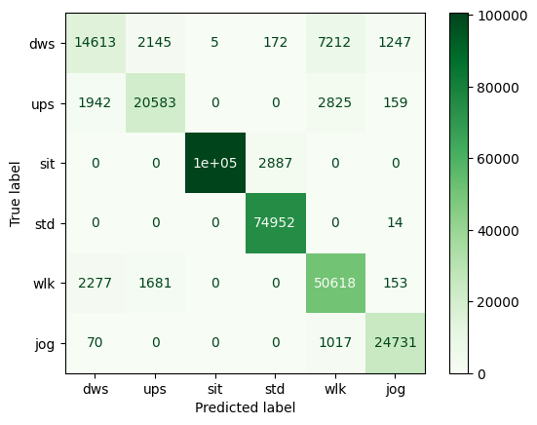
Figure 4.1 : Confusion Matrix for Accelerometer Data

Slide 33
Based on the given accuracy results for different machine learning models applied to accelerometer data, the following conclusions can be drawn:
Lag Features: Creating lag features for accelerometer data significantly improves the accuracy of the models. The Random Forest Classifier and CNN models show a notable increase in accuracy for most of the activity labels after creating lag features compared to the initial accuracies without lag features.
Combination of Gravity and Acceleration Coordinates: Combining gravity and acceleration coordinates also improves the accuracy of the models. The Random Forest Classifier and CNN models show improved accuracy for most of the activity labels after combining gravity and acceleration coordinates compared to the initial accuracies without combining them.
Best Performing Model: Among the three models (Decision Tree Classifier, Random Forest Classifier, and CNN), the CNN model consistently shows the highest accuracy for most of the activity labels across all scenarios (initial data, lag features, and combined gravity/acceleration coordinates).

Slide 34
Activity-wise Performance: The accuracy of the models varies across different activity labels. For example, the "sit" activity consistently has the highest accuracy across all scenarios, while "dws" and "ups" activities show lower accuracy compared to other activities in most cases.
Overall Performance: In general, the Random Forest Classifier and CNN models outperform the Decision Tree Classifier in terms of accuracy across all scenarios. The overall accuracy of the models improves after creating lag features and combining gravity/acceleration coordinates, with the Random Forest Classifier and CNN models achieving high accuracy rates above 90% in most cases

Slide 37
Based on the given accuracy results for different machine learning models applied to gyroscope data, the following conclusions can be drawn:
Combined Features: Combining features for gyroscope data significantly improves the accuracy of the models. The Random Forest Classifier and CNN models show a notable increase in accuracy for most of the activity labels after combining features compared to the initial accuracies without combining them.
Best Performing Model: Among the three models (Decision Tree Classifier, Random Forest Classifier, and CNN), the CNN model consistently shows the highest accuracy for most of the activity labels across all scenarios (initial data and combined features).
Activity-wise Performance: The accuracy of the models varies across different activity labels. For example, the "sit" activity consistently has the highest accuracy across all scenarios, while "dws" and "ups" activities show lower accuracy compared to other activities in most cases.
Overall Performance: In general, the Random Forest Classifier and CNN models outperform the Decision Tree Classifier in terms of accuracy across all scenarios. The overall accuracy of the models improves after combining features, with the Random Forest Classifier and CNN models achieving high accuracy rates above 90% in most cases.

Slide 40
Based on the given tables of accuracies for different machine learning models applied to Accelerator+Gyroscope data with and without lag features and rolling features, the following conclusions can be drawn:
Comparing the models without any additional features:
The Random Forest Classifier has the highest accuracy among all models with an accuracy of 80.74220247%.
The CNN model has an accuracy of 77.52452334%.
The Decision Tree Classifier has the lowest accuracy of 76.89028088%.
After creating lag features:
The Random Forest Classifier shows a significant improvement in accuracy, reaching an accuracy of 94.4312332%.
The CNN model also improves but not as much, reaching an accuracy of 91.31759706%.
After applying rolling features:
The accuracy of the models improves further, with the Random Forest Classifier having an accuracy of 95.76462386% and the CNN model having an accuracy of 96.84815973%.
The CNN model shows a higher accuracy compared to the Random Forest Classifier after applying rolling features.
In conclusion, adding lag features and rolling features to the Accelerator+Gyroscope data improves the accuracy of both the Random Forest Classifier and the CNN model. The CNN model performs better than the Random Forest Classifier after applying rolling features. Overall, the CNN model shows higher accuracy compared to other models in all scenarios (with and without additional features).

